Slide 1
Workforce Planning Working Group Tools NIH Exit Survey/Action Planning Overview
Workforce Support and Development Division (WSDD), Workforce Planning & Analytics Section

Slide 2
NIH Exit Survey
The purpose of the NIH Exit Survey is to provide the NIH Community insight into the opinions of exiting employees through custom reports for NIH and component organizations.
The utilization of the data has proven to be invaluable for succession planning for NIH and specific IC’s.
the NIH Exit Survey is an online survey for NIH FTEs with a separation action
Also includes transfers, retirements, and expired appointments
Managed by Workforce Support and Development Division (WSDD), Workforce Planning & Analytics Section

Slide 3
Who can take the NIH Exit Survey?
IC participation is voluntary
Each IC has a POC to manage Exit Survey
FTE employees are eligible (no contractors) who are leaving NIH, transferring ICs, or on an expiring appointment
All responses are anonymous
Quarterly and annual reports released in PIAP; NIH Exit Survey Response Dashboard

Slide 4
How can your IC benefit from the NIH Exit Survey?
Assess the reasons why employees are separating
Provide context to turnover data (the “why”)
Develop engagement and retention strategies
Provide insight into underlying organizational issues/areas for improvements
Open communication channels
Provide data for strategic workforce planning

Slide 5
NIH Exit Survey Reporting Dashboard - About
Results are presented based on participants responses, via the People Insight Analytics Platform (PIAP), NIH Exit Survey Results Dashboard
Filter data by
Fiscal/Calendar Year & Quarter
IC & Sub-org
Departure Type (Leaving NIH, Moving ICs, and Appointment Expired)
Series
Reason for Leaving
Components: Executive summary, charts/graphs for all question items, open-text responses, summary data and actual separations data (nVision)

Slide 6
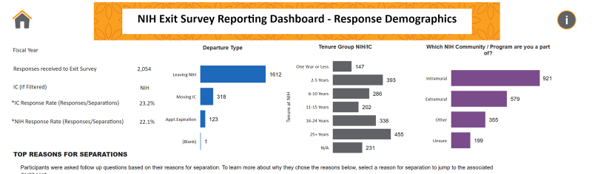
NIH Exit Survey Response Dashboard Data
Compare and contrast different response demographics
By type of separation and/or program
Compare the IC to NIH-wide results
Historical Trending (last 5 FYs) of Exit Survey response data
Overall satisfaction trends
Easily present data with by exporting or live demonstrations
Use in conjunction with other employee surveys
Link the NIH Exit Survey data to employee survey results to determine how employee engagement is impacting turnover
Use in combination with other workforce data
Tie opinion data with other data to obtain greater context

Slide 7
Exit Survey Distribution Process
ICs add the NIH Exit Survey to off-boarding checklists
The IC’s POC adds an Exit Survey invitation email to the off-boarding checklist.
When the AO sends the email to the employee, they can include the POC on the email. This allows the POC to track how many employees are receiving Exit Survey and ensure that they are not missing opportunities to send the survey departing employees.
Employees receive Exit Survey from WiTS when an action is entered
The Workflow Information Tracking System (WiTS) sends an automatic Exit Survey invitation email to employees when the HR Specialist enters an action to offboard someone leaving NIH.

Slide 8
How to Increase Participation
Employees leaving NIH receive an automated email invite
Internal to IC Or NIH do not
Create a standard process for distributing the Exit Survey within your work unit
Send the link as soon as you have confirmation that the employee is leaving
Add to YOUR Separating Employee Checklist
Encourage departing employees to participate by sending reminders
CC your survey POC to track a more accurate response rate

Slide 9
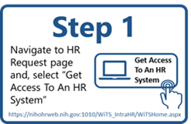
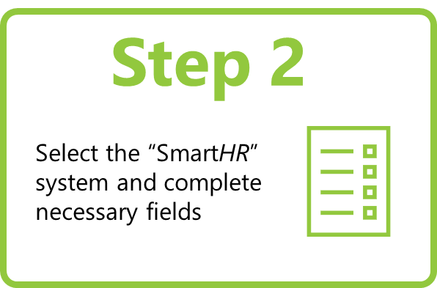
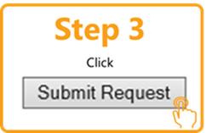
How to Request Access
Access and support requests managed by OHR HR Systems Support Helpdesk.
EO authorization is required for all access requests.
Granular security based on roles (Global, IC, EDI)
SmartHR is targeted to sunset by end of CY2022 and PIAP will launch shortly after.
In the interim, for access to PIAP, please select SmartHR.
https://hr.nih.gov/hr-systems/request-hr-systems-access

Slide 10
Access and Support
Program Management:
Workforce Support and Development Division (WSDD), Workforce Planning & Analytics Section
Email: NIH-WORKFORCE-PLANNING@od.nih.gov
People Insight Analytics Portal
NIH Exit Survey Response Dashboard: https://nih.sharepoint.com/:u:/r/sites/OD-OHR-People-Insights-Portal/SitePages/Exit-Survey.aspx?csf=1&web=1
Helpdesk:
Email: hrsystemssupport@od.nih.gov
HR Systems Helpdesk Requests: http://hr.od.nih.gov/hrsystems/help.htm

